Slide 1


THE BANKING SYSTEM
REQUIREMENT ELICITATION

Slide 2
Git link
https://github.com/cse25-317/OOAD-2026-ASSIGNMENT

Slide 3
Functional requirement (what the system does)
System shall must:
Register a new customer with name, address and phone number
Let a registered customer login with Customer ID AND PIN and shall reject invalid credentials
Let a customer open a Savings, Investment and Cheque account
Reject every withdrawal from a Savings account
Let a customer have several accounts, in any combination of the 3 types
Let a customer deposit any amount greater than zero into any account they hold
Shall only open a Cheque account for an employed customer and shall record employers' home and address
Let a customer withdraw funds from Investment and Cheque accounts and reject withdrawals that exceed the balance
Pay monthly interest 0.05% for Savings account, and 5% for Investment account
Record every deposit, withdrawal and interest payment as a transaction resulting balance and referencing with date and amount
Only open an Investment account when the opening deposit is at least P500.00
Let a customer view the balance, and transaction history of each amount

Slide 4
Non-Functional Requirement
Security- Encrypt all data, give passwords and restrict to own accounts
Accuracy- amounts should be in Botswana Pula currency to 2.d.p
Performance- Responds within a couple of seconds
Data Integrity-Balances stay accurate, transactions can't be half complete
Usability- Simple screen, clear error message
Reliability- Data persists after shutdown (should retain all account and transaction data after shutdown)
Authentication- a customer must log in with a username and password before using the account
Authorization- a customer can only sec and transact on accounts they had never someone else's
Lockout/limits- Repeated failed logins are blocked or delayed
Encapsulation- account is private, changed through methods (deposits(), withdraw())
Maintainability- Layered design(a new account type shall be addable by creating one new subclass of account without modifying existing account classes)

Slide 5
Interview Questions And Answers
Questions
Who will use the system?
What details do you need for each customer?
Can one customer have more than one account?
What are the rules for each account type?
When and how should interest be paid?
Should customers log-in, and how?
What should happen if someone tries to withdraw more than they have?
What records of transactions do you need to keep?
Apart from the features, what matters most to you: Security, Speed, Accuracy and ease of use?
Is there anything you don’t want in this first version, such as transfers, overdrafts and closing accounts?
ANSWERS
Customers: As individuals, companies, institutions
Name, phone number and address
Yes, they can have a savings, investment and cheque accounts
Savings: Deposit, no withdrawals and 0.05% monthly interest; Cheque: Deposit, withdrawals, no limit, no interest(for employed customers); Investment: Deposit, withdrawals, no limit, 5% monthly interest, opens only with P500.00 or more
Once a month, automatically and must appear in the accounts transaction history
Yes, with customer ID and PIN
System must refuse and leave the balance unchanged
Deposits, withdrawals, monthly interests and loans
Security, speed, accuracy and ease of use
Closing accounts, overdrafts and transfers

Slide 6
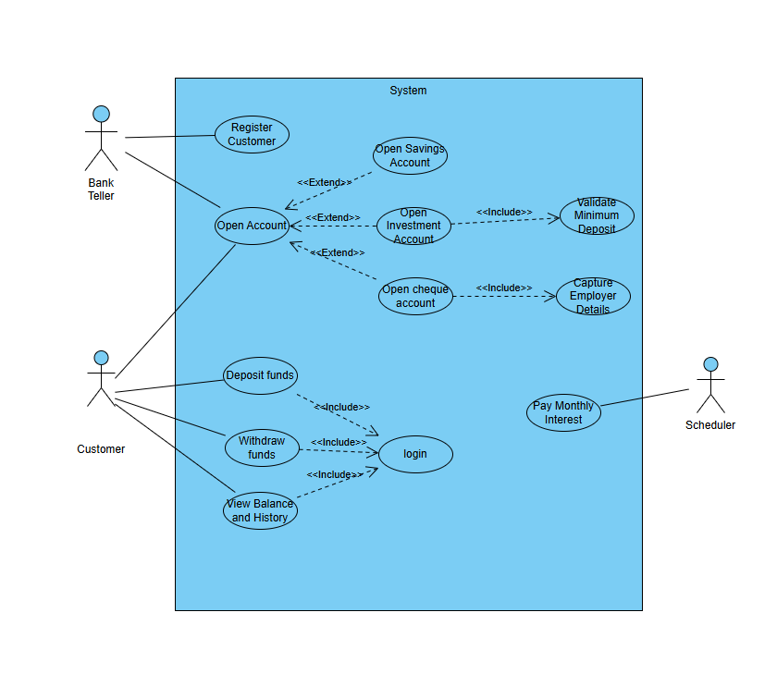
Structural UML Diagram

Slide 7
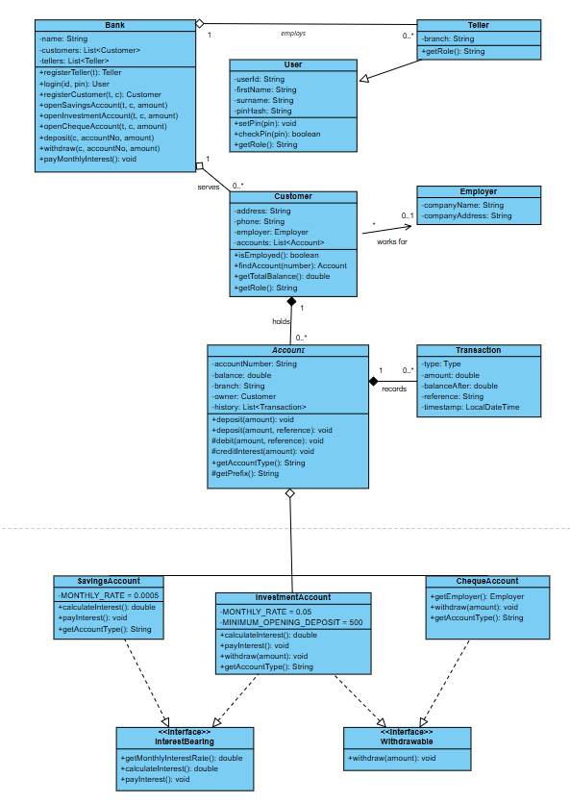
Class Diagram

Slide 8
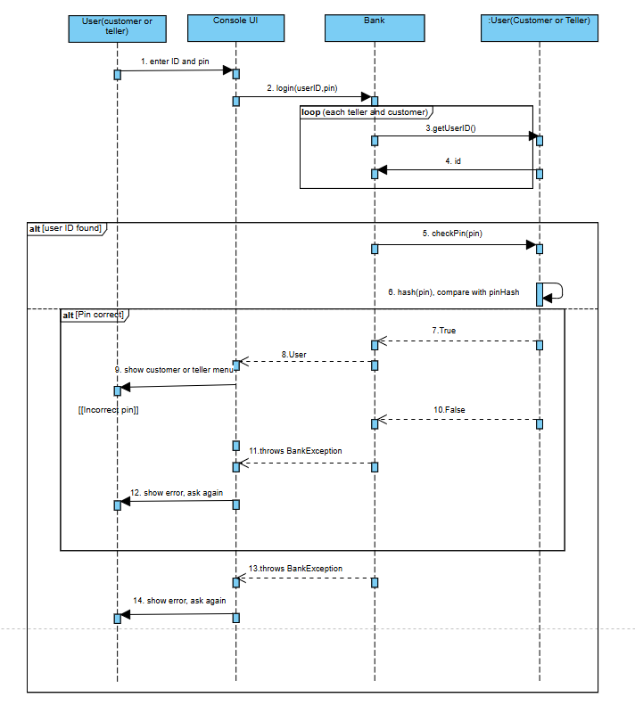
LOG-IN Sequence Diagram

Slide 9
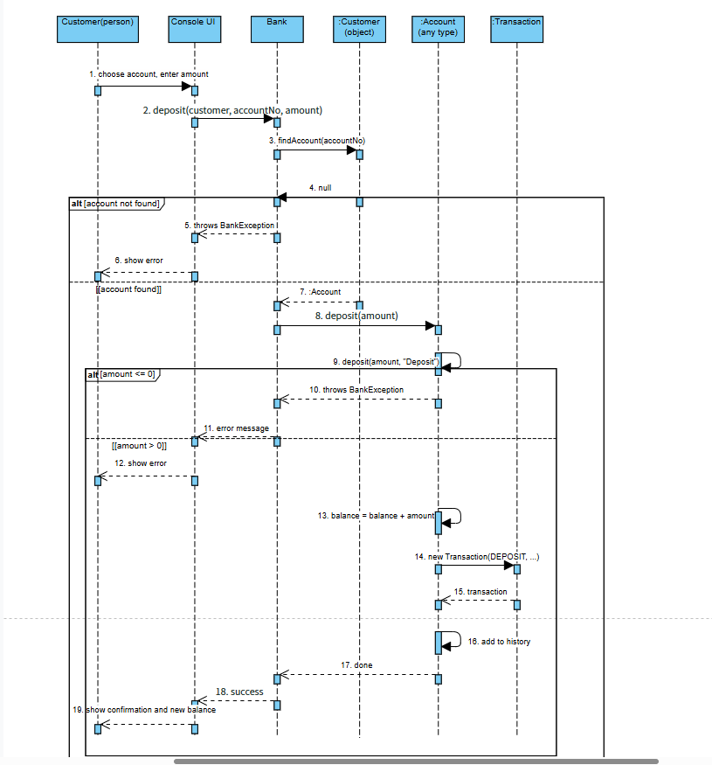
Deposit Funds Sequence Diagram

Slide 10
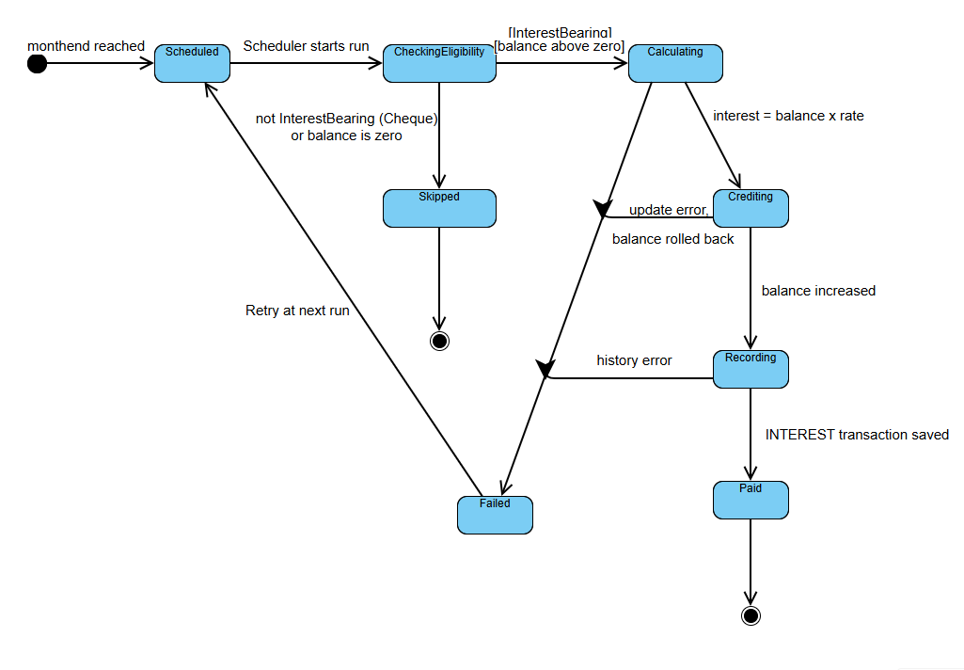
Pay Interest State Diagram

